Slide 1
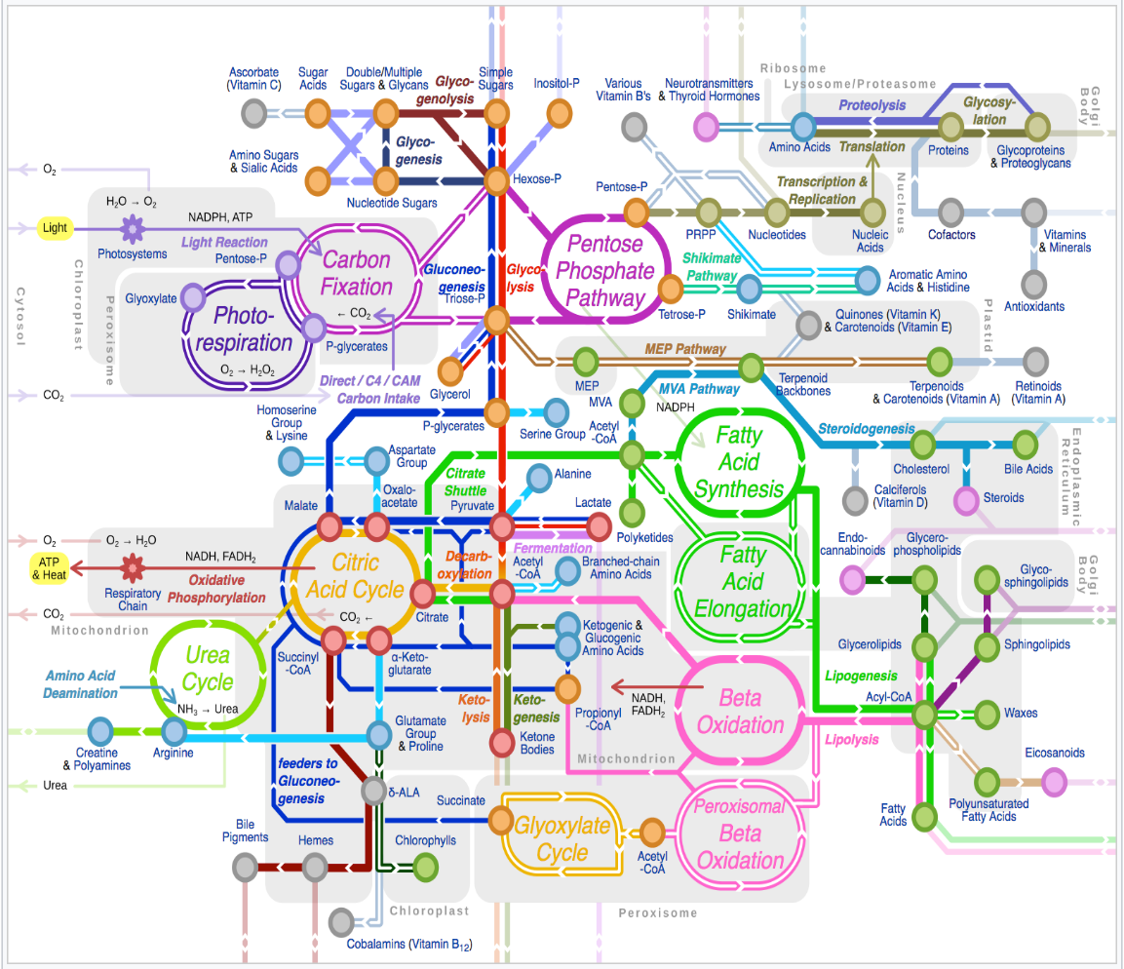


Why is isotopic labeling useful in metabolomics?
  Isotopic labeling allows the detection of isotope accumulation within metabolites that are under homeostatic control.
Homeostasis keeps many intermediate metabolites within tightly-controlled concentration ranges.
While metabolites that accumulate in resevoirs can change significantly, intermediates of metabolism may not change much.
However, isotopes from an enriched metabolite source can accumulate to detectable levels within intermediate metabolites of interest.
https://en.wikipedia.org/wiki/Metabolic_network
Isotopic Labeling

Slide 2
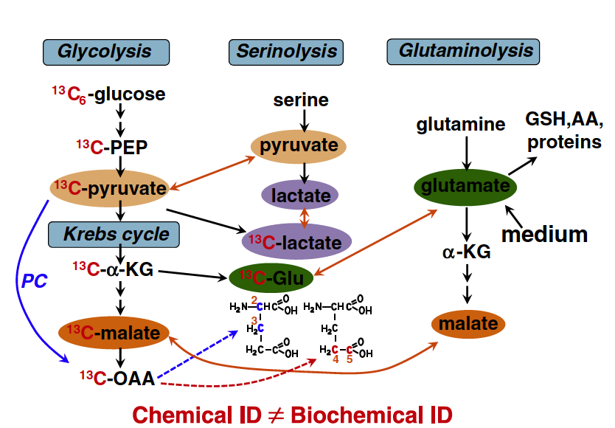
Why is isotopic labeling useful in metabolomics?
  Isotopic labeling facilitates placement of measured metabolite abundances within a metabolic network.
Chemical identification of a metabolite may not help determine what part of the metabolic network is being perturbed.
Detection of labeled metabolite substructure can help place isotope accumulation within a metabolic path context.
Fan et al, Pharmacology & Therapeutics, 133, 366 (2012).
¹³C₆-Glc
αKG
Glu
¹³C₆-Gln
1
1
1
1
2
2
2
2
3
3
3
3
4
4
4
4
5
5
5
5
6

Slide 3
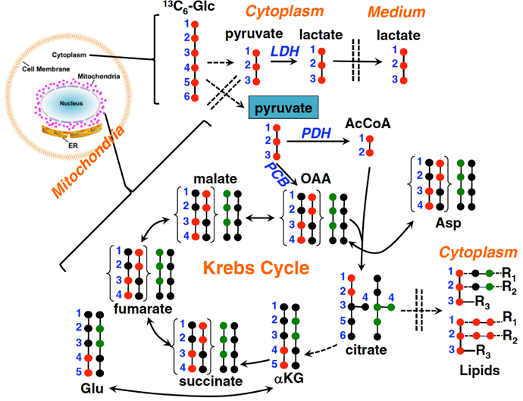
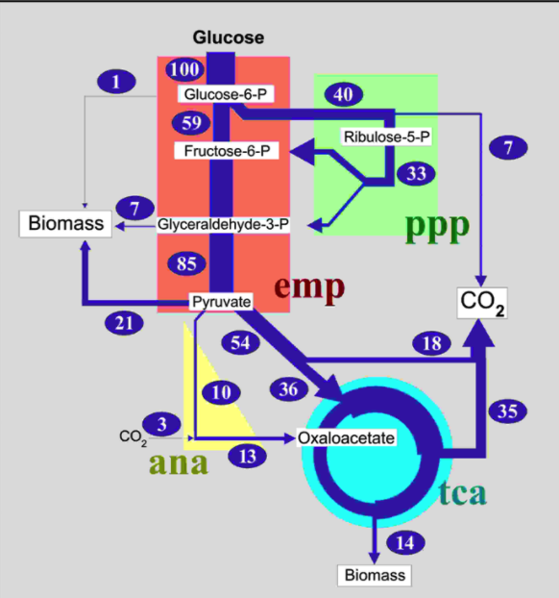
Why is isotopic labeling useful in metabolomics?
  Isotopic labeling facilitates the measurement of isotopic flux, which can be interpreted in terms of metabolic flux.
Isotopic Flux
Metabolic Flux
Interpreted
Fan et al, Pharmacology & Therapeutics, 133, 366 (2012).
https://www.13cflux.net/13cflux2/mfa.jsp%3Bjsessionid=1FC4F4B2D7F8ADF775F0314689B71C7A

Slide 4
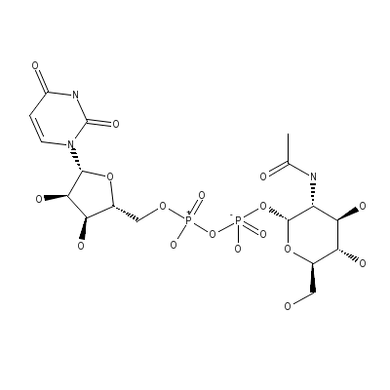
Pathway Contributions to ¹³C Labeling of UDP-GlcNAc from ¹³C-Glucose
Glycolysis+Krebs Cycle
¹³C₆-Glucose
¹³C₆-Glucose
U
hexokinase
A
Glycolysis
PPP
Glycolysis
¹³C₆-Glucose-6-P
R
phosphohexose
isomerase
¹³C₃-Pyruvate
G
pyruvate
dehydrogenase
complex
¹³C₆-Fructose-6-P
UDP-GlcNAc
glucosamine -fructose 6-P
aminotransferase
Hexosamine
¹³C₂-Acetyl-CoA
¹³C₆-Glucosamine-6-P
¹³C₂-Acetyl-CoA
glucosamine 6-P
N-acetyltransferase
Krebs Cycle
CoA
¹³C?-Oxaloacetate
¹³C₈-N-acetylglucosamine-6-P
aspartate
aminotransferase
P acetyl glucosamine
mutase
carbamoyl
phosphate
synthetase II
¹³C?-Aspartate
¹³C₈-N-acetylglucosamine-1-P
+
UDP-N-acetylglucosamine
pyrophosphorylase
Carbamoyl
phosphate
CO₂
Pyrimidine
Biosynthesis
¹³C?-UDP-N-acetylglucosamine
(UDP-GlcNAc)
+
¹³C₆-Glucose
PRPP
(¹³C₅-Ribose)
UDP-glucosamine
epimerase
PPP
¹³C?-UDP-N-acetylgalactosamine
(UDP-GalNAc)
Moseley et al. BMC Biology 9, 37 (2011).

Slide 5
Comparison of UDP-GlcNAc Derived Pathway-Specific Relative Metabolic Flux Biomarkers
U
Example: LNCaP-LN3 prostate cancer cells with and without MSA (methylselenic acid).
A
R
G
Without MSA
With MSA
(Glycolysis)
(Hexosamine Biosynthetic Pathway)
(Pentose Phosphate Pathway)
(Glycolysis+Krebs Cycle)
¹³C Accumulation
Time Course
Time Course
This is an interpretation of isotopic accumulation within chemical functional groups in terms of pathway-specific relative flux.

Slide 6

How do I get the isotope label into the metabolites
I am interested in?
What source metabolites will be taken up by the system I am studying? How will it be taken up?
  Know thy biological system or consult with someone that knows.
Will a source metabolite trace through the pathways of interest to the metabolites of interest?
  Study the relevant metabolic network.
Can I get the labeled version of this source metabolite at a reasonable price?
  Negotiate with the vendors.
How long and much of the source metabolite is needed for my experiments?
  Draw from previous experiments, but also test how long it takes for isotope to enter metabolites of interest.

Slide 7
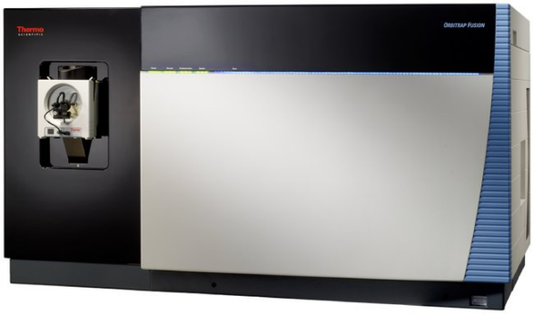
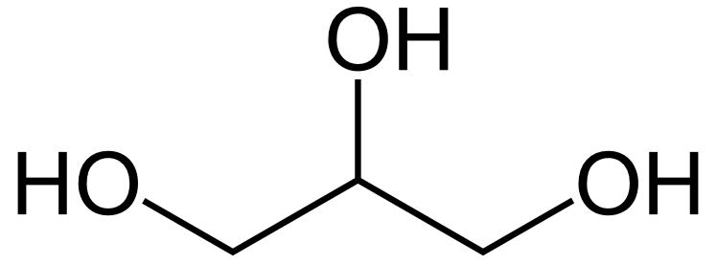
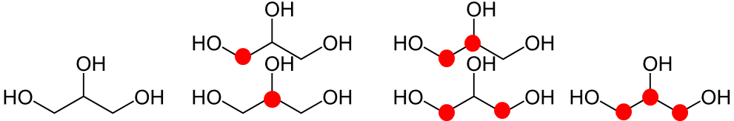
Detecting Metabolites Labeled with Stable Isotopes
Nuclear Magnetic Resonance (NMR)
Mass Spectrometry
(MS)
Detected features identify the location of stable isotopes within the metabolite.
Detected features identify the number of stable isotopes within the metabolite.
Isotopomer – molecules with identical isotopic composition but differing by the position of isotope.
Isotopologue – set of molecules that differ only in their isotopic composition.

Slide 8
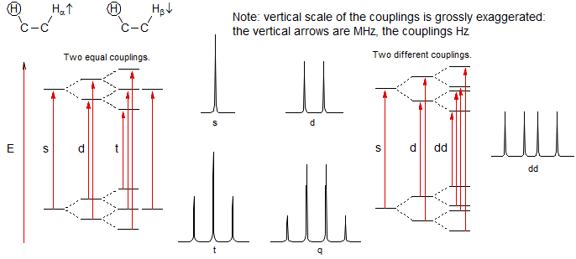

Isotopomer Definitions
Isotopomer – molecules with identical isotopic composition but differing by the position of isotope.
  Examples:
Partial Isotopomer - part of an isotopomer where the isotopic content of specific atoms is known.
  In NMR, spin-spin coupling (J-coupling or scalar coupling) can produce peaks that indicate the isotopic status of neighboring atoms.
  Example:
We need the ability to annotate these peaks in an isotope-informative manner.
H
H
H
D
H
C
C
H
C
C
H
H
H
H

Slide 9
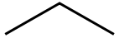
Isotopologue Definitions
Isotopologue – set of molecules that differ only in their isotopic composition.
  Examples: ¹²C₃¹H₈¹⁶O₃, ¹²C₂¹³C₁¹H₈¹⁶O₃, ¹²C₁¹³C₂¹H₈¹⁶O₃, ¹³C₃¹H₈¹⁶O₃
Isotopologue Fragment - a refined set of isotopomers where the ambiguity of isotope location is limited to a subset of the atoms.
  Tandem mass spectrometry can provide spectral features that indicate where isotopes are localized within a chemical structure.
  Example:

Slide 10
Other SIRM-Specific
Experimental Design Questions
Can isotopologue and/or isotopomer data enable the answering of the main biological questions?
  For example:
Can the metabolites of interest be detected and accurately assigned by the analytical technique that will provide the isotope-specific data that is needed?
¹³C₆-Glc
¹³C₆-Glc
αKG
citrate
1
1
1
1
2
PDH
2
2
PDH
3
2
4
4
3
VS
3
3
4
4
4
5
5
PCB
5
5
PCB
6
6
6
Requires isotopomer-specific or isotopologue-fragment information to distinguish.
Isotopologue-specific information is adequate to distinguish.

