Slide 1


Introducing the InChI for Nanomaterials (NInChI)
Prof. Iseult Lynch, University of Birmingham
Dr. Antreas Afantitis, Novamechanics Ltd.
Dr. Thomas Exner, Seven Past Nine

Slide 2
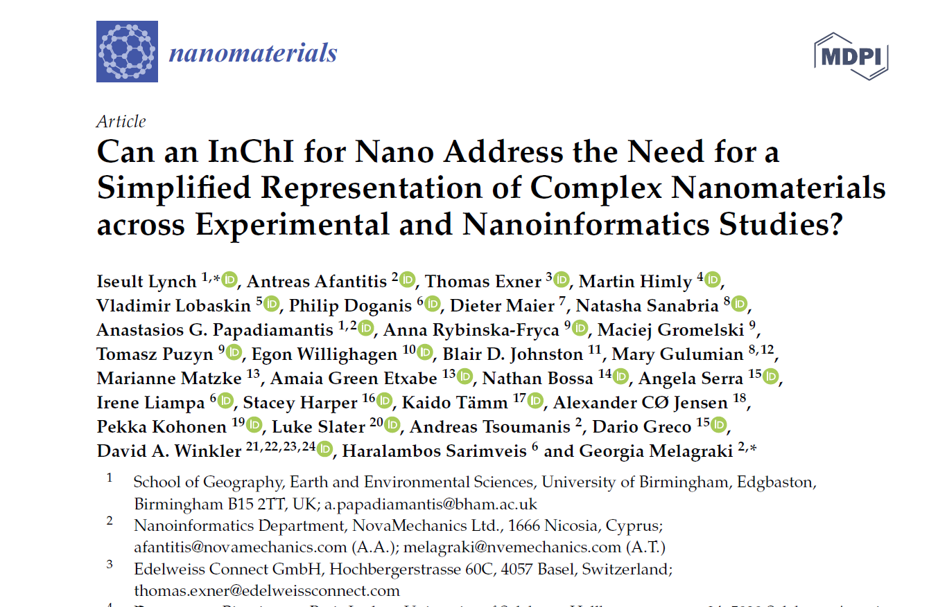
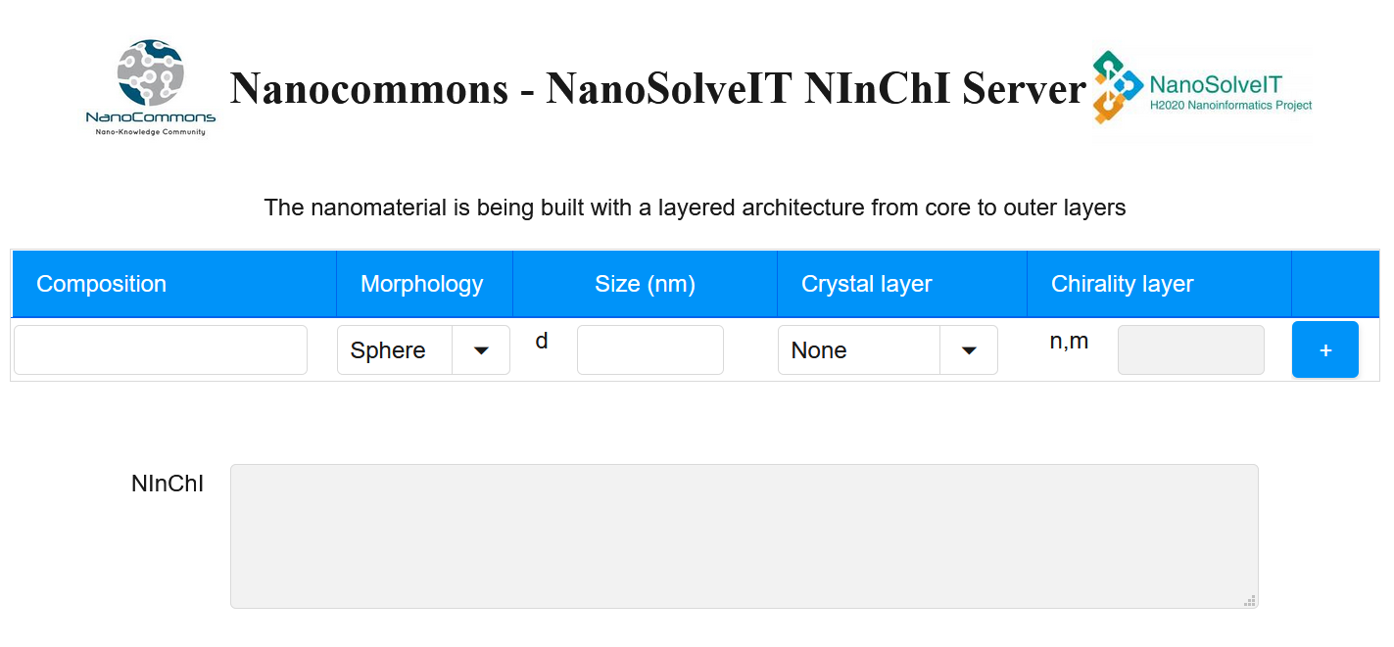
Alpha version – published Dec 2020 – NInChI generator
https://www.mdpi.com/2079-4991/10/12/2493
http://enaloscloud.novamechanics.com/nanocommons/NInChI/

Slide 3
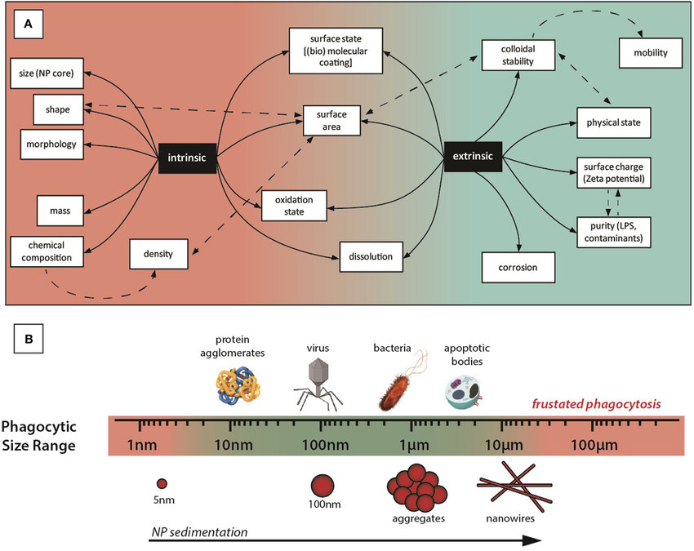
Intrinsic versus extrinsic properties of Nanomaterials
https://www.frontiersin.org/articles/10.3389/fimmu.2017.00970/full

Slide 4
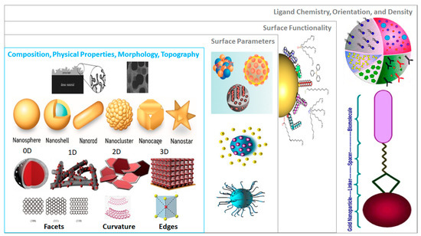
Challenges of distinguishing nanomaterials
Crystal phase or mixed phases
Chirality
Dopants
Defects
Powder vs dispersion (Mixtures InChI)
InChI
Polymer InChI

Slide 5
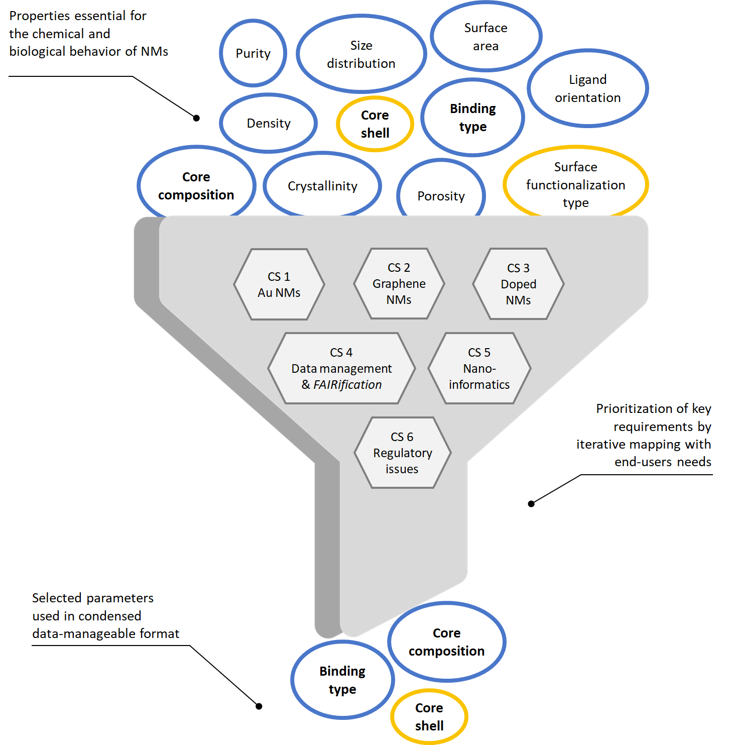
Nanomaterial identifier - InChI for nano
Case studies
1. Library of Au NMs of different sizes and surface functionalities
(ligands)
2. Library of carbon nanotubes
3. Complex chemistries and structures (Multi-metallics
– doped / core-shell)
4. NM-related data management and incorporation into the FAIR
data landscape
5. NInChI in Nanoinformatics
6. Regulatory challenges (e.g., nanoforms / sets of nanoforms)

Slide 6
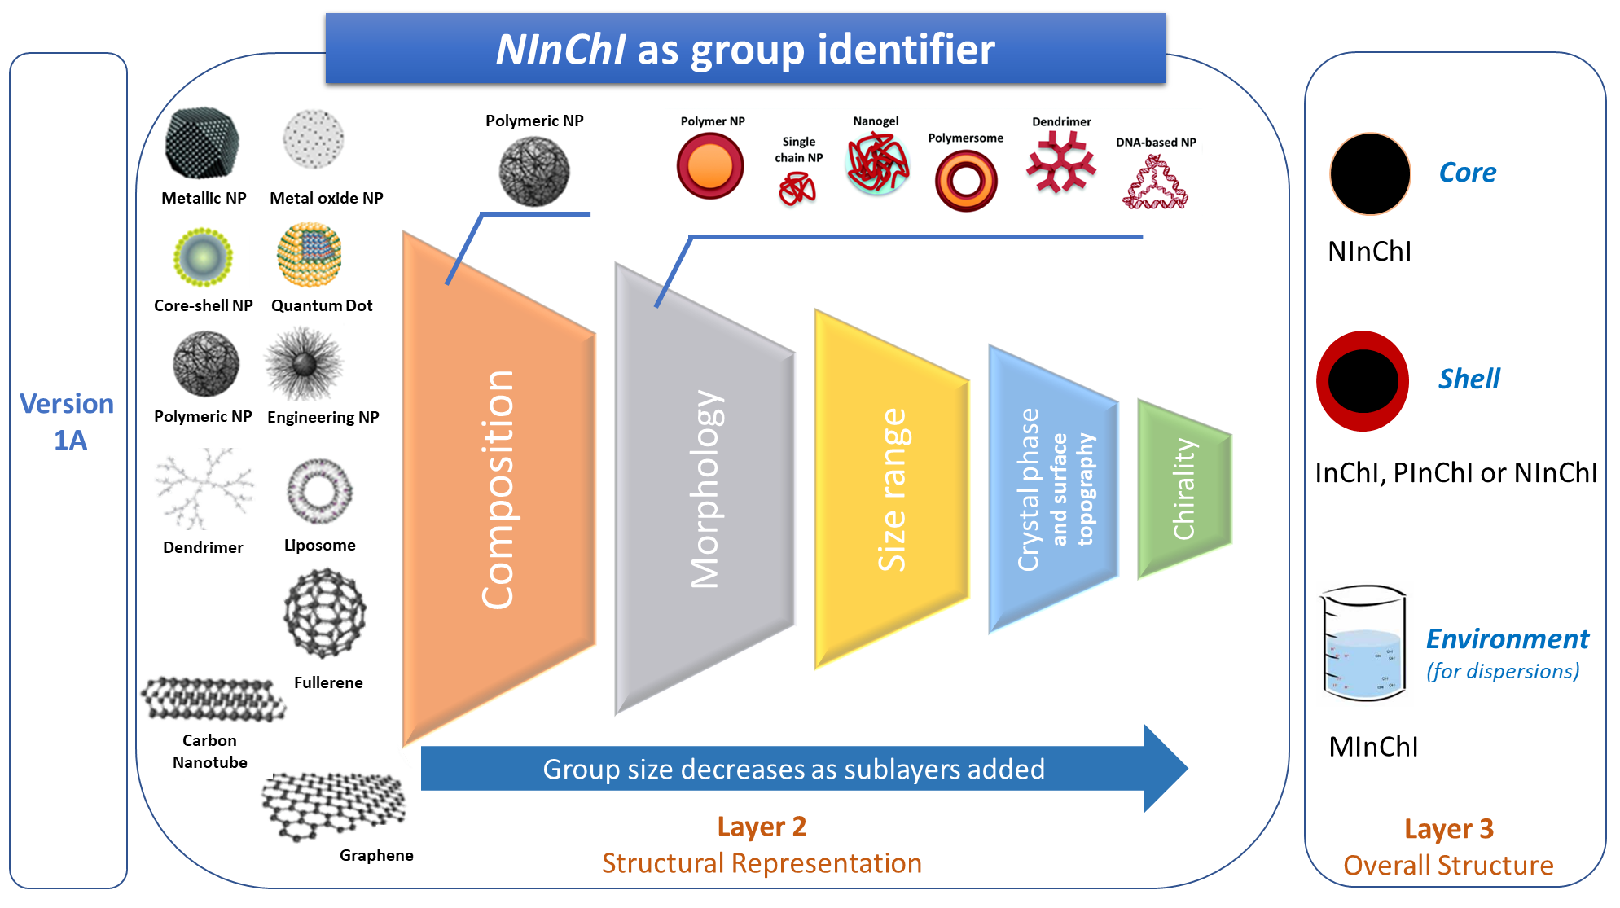
NInChI – enhancing interoperability of data – supporting “nanoforms”

Slide 7
Building on Existing InChI concepts

Slide 8
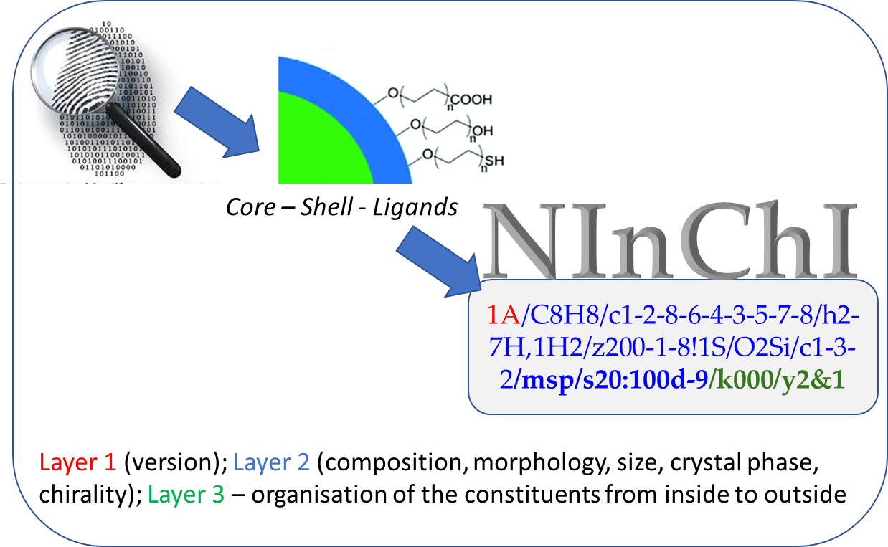
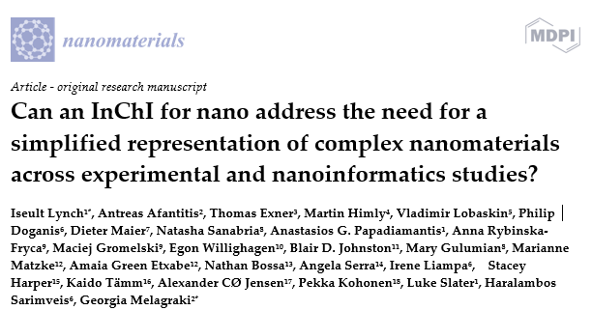
NInChI as a structural nanomaterial identifier

Slide 9
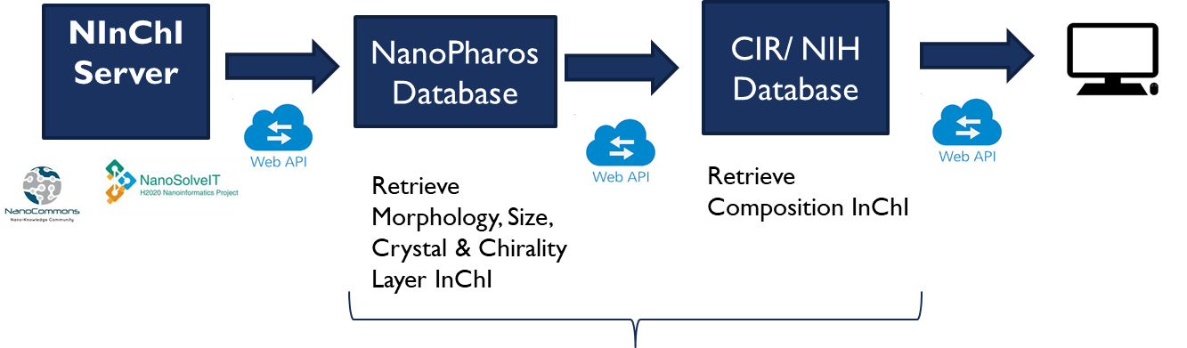

Technical implementation
Future Plans: Include theses steps in the InChi software

Slide 10
Join our NInChI WORKING GROUP
Email i.lynch@bham.ac.uk to sign up
1st NInChI working group meeting Wednesday 7th April 2021 – 5pm UK, 6pm CET, noon EST
Terms of reference:
Is a nanomaterial an extension of a molecule, or is a molecule a component of a nanomaterial?
Is the nanomaterial InChI canonical?
Can developments of the core InChI, including improved descriptions of organometallics and inorganics, fit easily into the Nano InChI without requiring substantial reprogramming?
Does the Nano InChI describe nanomaterials in a way which is globally accepted, or might take up in some regions be higher than in others?
How should the Nano InChI software interact with the core InChI software?

Slide 11
Initial responses for discussion by NInChI working group
Is a nanomaterial an extension of a molecule, or is a molecule a component of a nanomaterial? If it is the former, then an AuxInfo approach might be best.
→ Nanomaterials are materials, not molecules - multiple InChIs are currently used as part of the NInChI
Is the nanomaterial InChI canonical? The RInChI achieves this by minimising the information in the main string, and using AuxInfo to hold anything with a floating point number
→ Not yet since properties can be quantified using different measures (e.g. radius or diameter for spherical NM)
→ Proposal of NInChI also as a group identifier makes canonicalization even more demanding
→ Transferring the values into AuxInfo should be tested
Notes:
Point 1: They can have different shells or are mixtures, only simplest materials can be described based on just one “molecule” building the core. Even if ECHA is using NanoForms based on CAS numbers, the NInChI was actually designed to overcome these limitations.
Point 2: First could probably be solved by just provide rules what measure to use. However, that we want to also describe groups e.g. for size ranges makes it quite hard → a material could be defined with a specific size or as part of a size range depending on the information we have on the material. To solve this, the NIChI could specify that it is a spherical NM and then the specific sizes is given in the AuxInfo. This might be even help in classification and grouping. The first criterion would be find spherical particles and then in a second step would be used to classify the size groups. The second part would then be in charge to concert between different measures and also compare NInChIs describing already broader groups (between 1 and 5nm).

Slide 12
Initial responses for discussion by NInChI working group
Can developments of the core InChI, including improved descriptions of organometallics and inorganics, fit easily into the Nano InChI without requiring substantial reprogramming?
→ Existing descriptions should definitely be used - this is already done with mixture and polymer InChIs
→ Will need reprogramming, but the NovaMechanics team have the capability to do this
Does the Nano InChI describe nanomaterials in a way which is globally accepted, or might take up in some regions be higher than in others?
→ Large efforts were taken to collect views from as many researches across the world to get consensus inside the nanosafety community - outreach has been started towards other communities and has resulted in immense interest
Notes:
Point 2: 90% of first NInChI paper is consensus finding and transform this into a model for the NInChI with the agreed set of minimal properties (to perhaps be extended)

Slide 13
Initial responses for discussion by NInChI working group
How should the Nano InChI software interact with the core InChI software? Would the aim be to integrate it, or could it be an independent program which called the core software whenever an InChI needed to be generated?
→ NInChI software will need to provide specific functionality and being independent, at least at the beginning, will allow faster development of these
→ Core software already used for creating the InChI for the components
→ Mutual exchange of functionality between the core and the NInChI software might make merging beneficial later on
→ Currently we are extracting the InChIs for the elements from the core InChI software

Slide 14
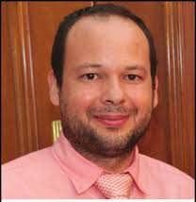
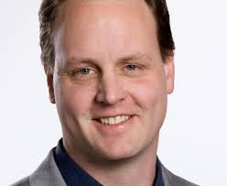
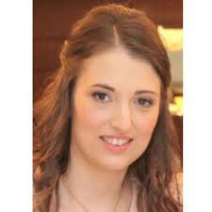



Acknowledgements
Dr. Antreas Afantitis
Novamechanics Ltd.
Dr. Thomas Exner
Seven Past Nine
Dr. Georgia Melagraki
Novamechanics Ltd.
Dr. Martin Himly
Paris-Lodron University of Salzberg
Dr. Andreas Tsoumanis
Novamechanics Ltd.
Email: i.lynch@bham.ac.uk
to join the NInChI working group

