Slide 1
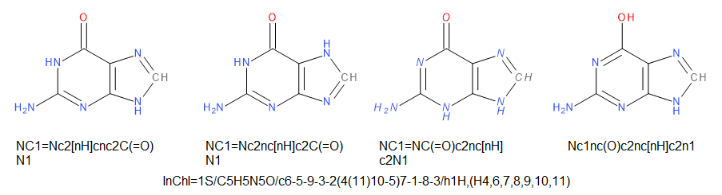
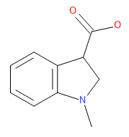
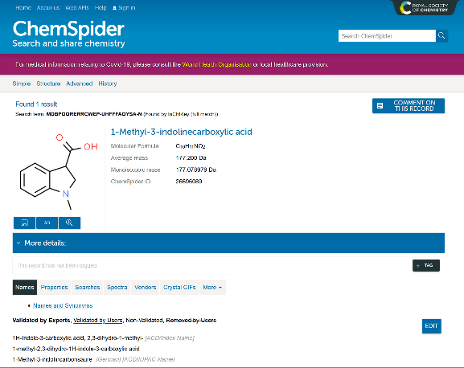
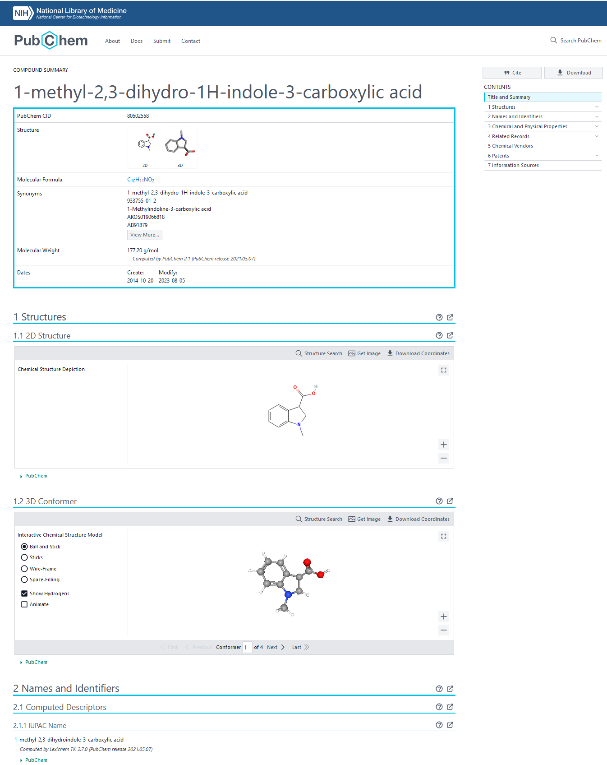
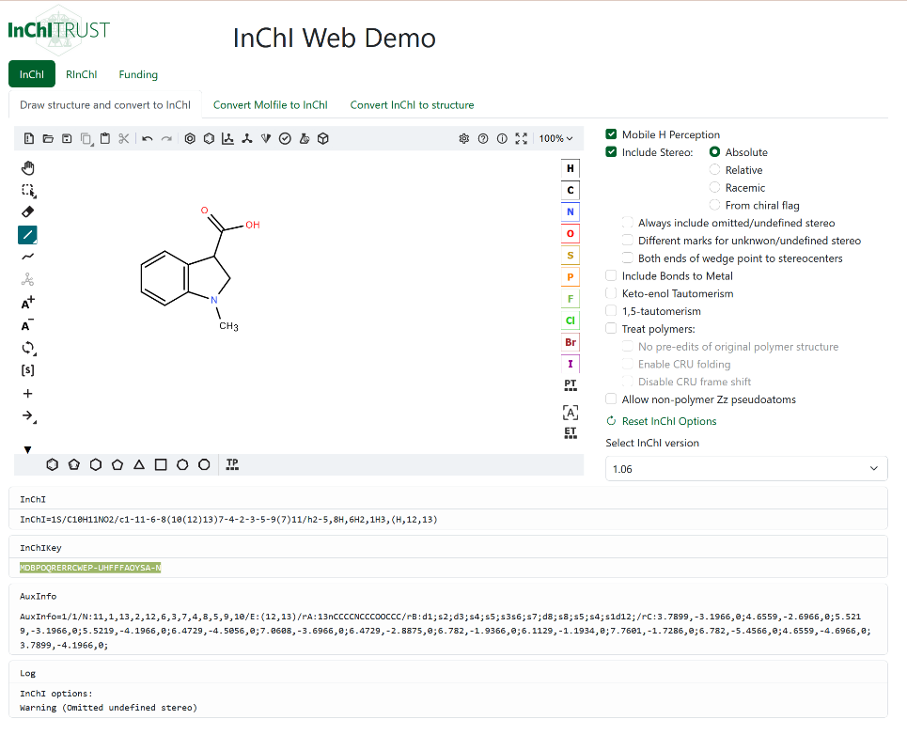
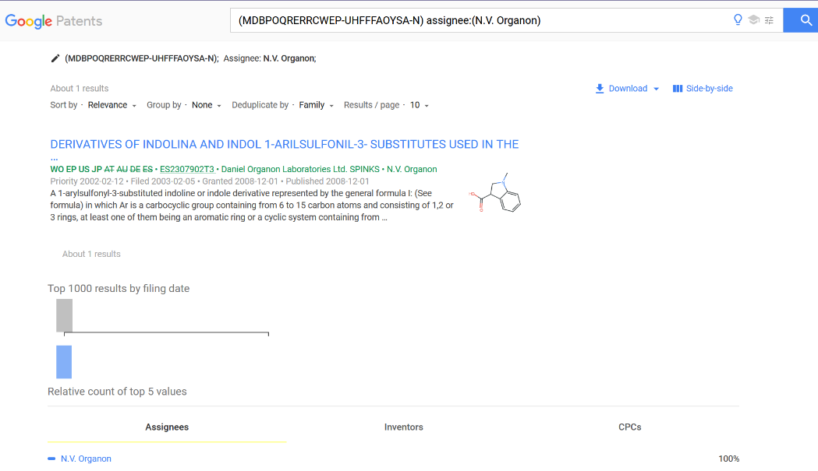
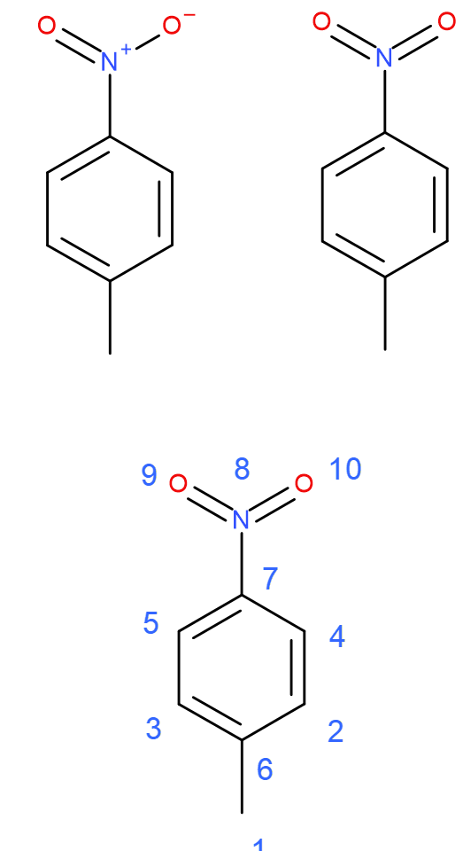
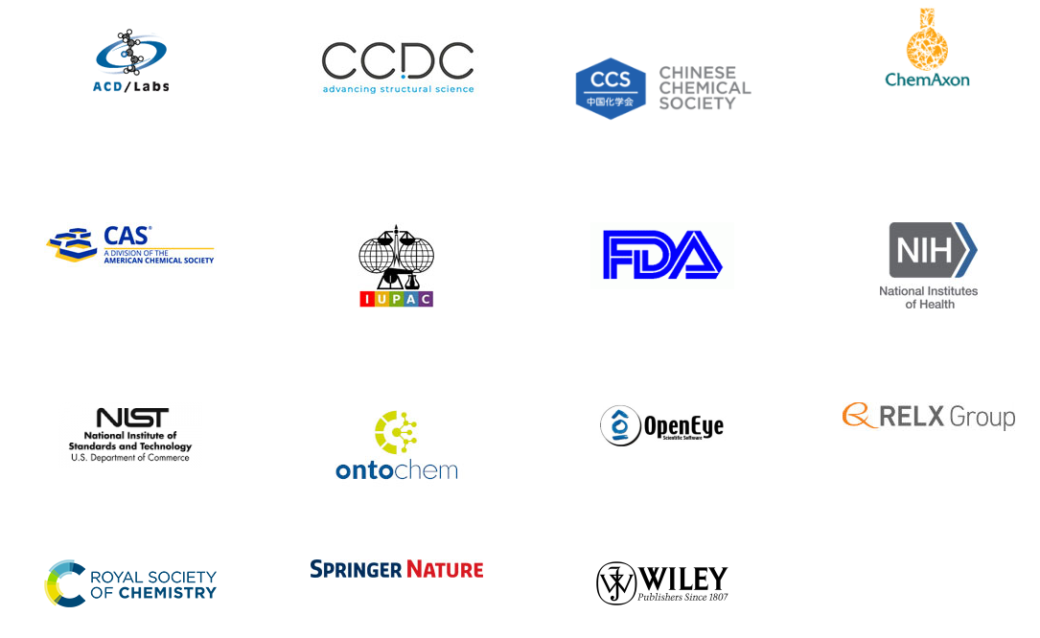
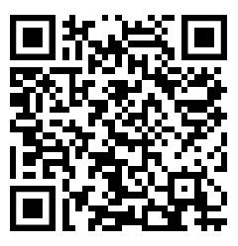
IUPAC International Chemical Identifier (InChI) The identifier that glues all steps in the research life cycle of a compound
Gerd Blanke^{1,4}, Jonathan M Goodman^{2,5}, Rudy Potenzone¹, and Stephen R Heller^{1,2,3}
¹InChI Trust, Cambridge, UK; ²IUPAC; ³NCBI, NLM, National Institutes of Health, Bethesda, MD, USA; ⁴StructurePendium Technologies GmbH, Essen, Germany; ⁵Yusuf Hamied Department of Chemistry, University of Cambridge, UK
Are these molecules all the same?
Extending InChI: Scientific Working Groups
Extended Stereochemistry
Extended Tautomers
Isotopologues
Large Molecules
Monomer Atoms
Organometallics/Inorganics
Variable Structure (Markush)
GitHub code development
Mixtures
Nanomolecules
QR Codes
Open Education Resource (OER)
Reactions
Resolver
Where do I find data for 1-methylindoline-
3-carboxylic acid?
Use https://iupac-inchi.github.io/InChI-Web-Demo/ or your favorite drawing editor to get the InChIKey for the structure
InChI release status: https://github.com/IUPAC-InChI
InChI versions:
Released
    Current version 1.06
      https://github.com/IUPAC-InChI/InChI_1_06
    Latest implemented enhancements
      Polymers (in beta status)
  Under development
    Requirements (nearly) ready
        Organometallics
        Stereochemistry
        Tautomers
        Isotopologues
        Full V2/V3 molfile support (for registration)
          Sgroups and Sgroup data
    Longer evaluations
      Large molecules
      Variable molecules / Markush InChIs
InChI Application Framework:
Released
    RInChI 1.0
    QR code (proposal published in 2022)
    Test Phase
    Resolver
    https://github.com/inchiresolver/inchiresolver#readme
    RInChI 1.1
    Test phase: https://github.com/IUPAC-InChI/RInChI
    Awaiting coding
    MInChI
    Prototype released: https://github.com/cdd/mixtures
    RInChI (1.2)
    Multithreading
    Atom mapping
    Under development
    NanoInChI (NInChI)
MDBPOQRERRCWEP-UHFFFAYOSA-N
InChI project goals
Create a free, non-proprietary chemical substance identifier:
Turn chemical structures into unique, canonical text strings
Enable discovery and linking of chemical and biological data
Release planning
InChI release 1.07 for the beginning of Q4, 2023
  Code clean up, about 10% faster, 6 tautomer transformations for testing
Complete priority enhancements of structure coverage:
  stereochemistry, organometallics, tautomers, isotopologues, etc
Stakeholder collaboration and partnership
Educational resources
Partnership
New Uses
New uses and extensions of the InChI standard
Promote the use of InChI and raise awareness
InChI is key for FAIR in chemistry and beyond
In particular– findability and reusability
Identifying unique entities for discovery and linking
then interoperability between structures and related (meta)data including qualified references to other (meta)data
InChI is critical to enable references based on chemical identity
Resources
Goals
Raise Awareness
InChI and InChIKey
InChI: built to work as a chemical identifier
Different representations must lead to same InChI
InChI organization
InChI= 1S (InChI version 1, Standard)
/C7H7NO2 (Formula C: 1-7, N:8, O: 9-10)
/c1-6-2-4-7(5-3-6)8(9)10 (Connectivity)
/h2-5H,1H3 (Hydrogen layer)
InChI Trust
InChI Trust
Board of Directors
Members and Supporters
InChI Sub-committee
Division VIII
CPCDS
Project Director
Part time
Technical Director
Part time
IUPAC
Development and Maintenance Programmers
Outreach Director
Part time
InChI = 1S/C7H7NO2/c1-6-2-4-7(5-3-6)8(9)10/h2-5H,1H3
InChI Trust
InChI Version
Formula
C: 1-7, N:8, O: 9-10)
Connectivity
Hydrogen layer
UK charity, 15 members
Annual membership fee
Core revenue $160k
Covers core maintenance, incre-mental expansion and outreach
InChIKey: Fixed-length hash of InChI: identity and web searches
  InChIKEY= ZPTVNYMJQHSSEA (formula, connectivity, hydrogens (hashed) )
  UHFFFAOY (remaining layers: stereochemistry, isotopes, etc. (hashed) )
  SA (Standard InChI, version 1 (= A) )
  N (Neutral / total charged atoms )
InChIKey = ZPTVNYMJQHSSEA-UHFFFAOYSA-N
Formula and connectivity hashed
Stereochemistry, etc. hashed
InChI version
Neutral
or charged
How can you support InChI?
  Become a member
  In-kind contribution to the open-source development on GitHub
  Charitable donation to the InChI Trust
  Work through InChI Trust certified consulting companies
  Participate in the scientific working groups –
  use-cases and solutions
  Contact us: contribute@inchi-trust.org
InChI adoption
Ubiquitous adoption by commercial, public, in-house databases and virtual repositories
Applications to Reactions (RInChI) and Mixtures (MInChI)
under active development

